Slide 1
Architecture of Enterprise Applications 25 Spark
Haopeng Chen
REliable, INtelligent and Scalable Systems Group (REINS)
Shanghai Jiao Tong University
Shanghai, China
http://reins.se.sjtu.edu.cn/~chenhp
e-mail: chen-hp@sjtu.edu.cn

Slide 2
Contents and Objectives
Spark
Basic Concepts
Spark Deploying
Quick Start
RDD
Spark SQL
Other Issues
Objectives
能够针对高性能计算需求，设计并实现基于Spark和Spark SQL的的内存并行计算方案

Slide 3

Spark
Apache Spark http://spark.apache.org/
Unified engine for large-scale data analytics
What is Apache Spark™?
Apache Spark™ is a multi-language engine for executing data engineering, data science, and machine learning on single-node machines or clusters.
Simple. Fast. Scalable. Unified.
The most widely-used engine for scalable computing
Thousands of companies, including 80% of the Fortune 500, use Apache Spark™. Over 2,000 contributors to the open source project from industry and academia.

Slide 4
Spark
Batch/streaming data
Unify the processing of your data in batches and real-time streaming, using your preferred language: Python, SQL, Scala, Java or R.
SQL analytics
Execute fast, distributed ANSI SQL queries for dashboarding and ad-hoc reporting. Runs faster than most data warehouses.
Data science at scale
Perform Exploratory Data Analysis (EDA) on petabyte-scale data without having to resort to downsampling
Machine learning
Train machine learning algorithms on a laptop and use the same code to scale to fault-tolerant clusters of thousands of machines.

Slide 5
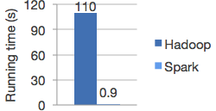
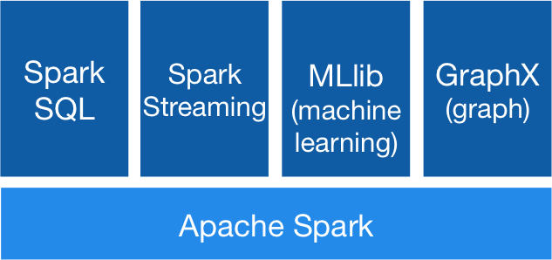
Spark
Outstanding performance
Run workloads 100x faster
Memory computing
Components for various usage
Spark Core
Spark SQL
Spark Streaming
MLlib
GraphX
Logistic regression in Hadoop and Spark

Slide 6

Spark & Hadoop
Hadoop
HDFS + MapReduce
MapReduce
MapReduce
Low utilization of memory and much disk I/O
Spark
Higher performance（100x faster）
Memory computing
More APIs
Capable of integrating with Hadoop (HDFS)
…

Slide 7

Example: Log Mining
Load error messages from a log into memory, then interactively search for various patterns
Base RDD
Cache 1
lines = spark.textFile(“hdfs://...”)
errors = lines.filter(_.startsWith(“ERROR”))
messages = errors.map(_.split(‘\t’)(2))
cachedMsgs = messages.cache()
Transformed RDD
Worker
results
tasks
Block 1
Driver
Cached RDD
Parallel operation
cachedMsgs.filter(_.contains(“foo”)).count
cachedMsgs.filter(_.contains(“bar”)).count
Cache 2
Worker
. . .
Cache 3
Result: full-text search of Wikipedia in <1 sec (vs 20 sec for on-disk data)
Worker
Block 2
Block 3

Slide 8
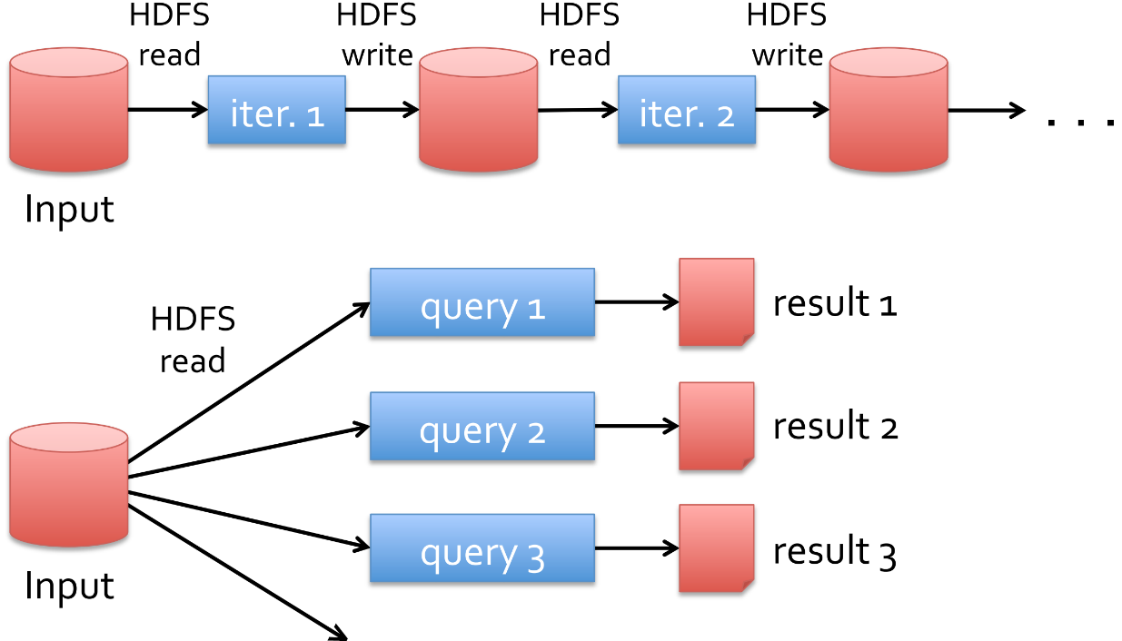
HDFS & Spark
Slow due to replication and disk I/O, but necessary for fault tolerance

Slide 9
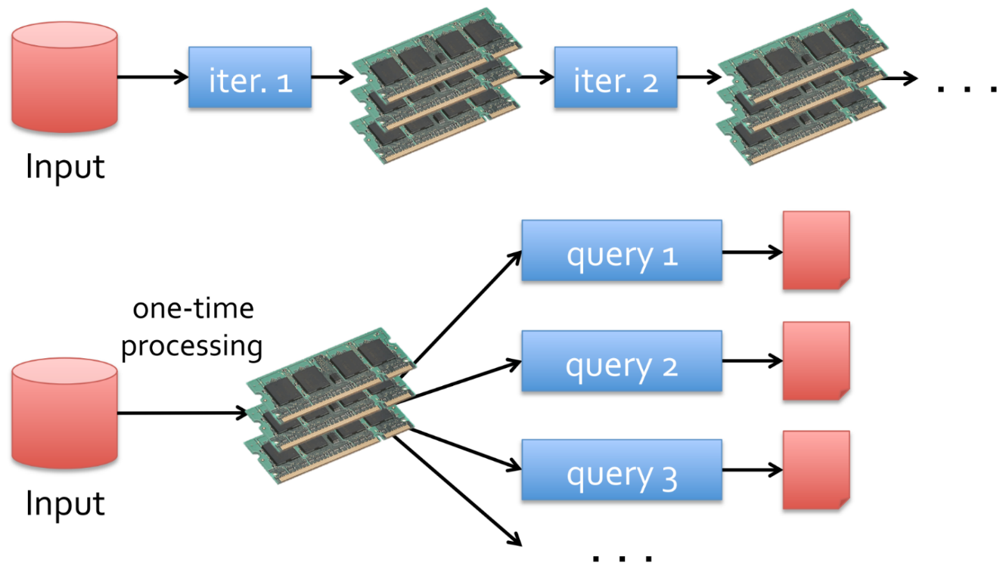
HDFS & Spark
10-100x faster than network/disk

Slide 10
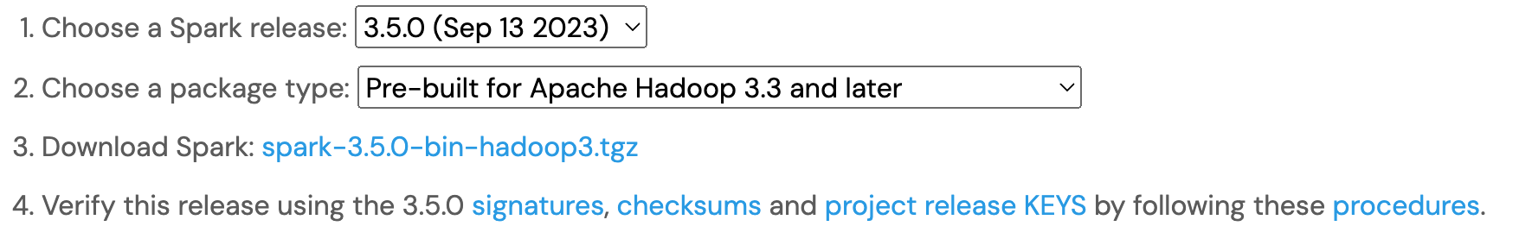
Download Apach Spark
Installing with PyPi
PySpark is now available in pypi. To install just run pip install pyspark.
Convenience Docker Container Images
https://hub.docker.com/r/apache/spark-py/tags
docker pull apache/spark-py:latest

Slide 11

Spark Components
Spark applications run as independent sets of processes on a cluster, coordinated by the SparkContext object in your main program (called the driver program).

Slide 12
Spark Components
Specifically,
to run on a cluster, the SparkContext can connect to several types of cluster managers (either Spark’s own standalone cluster manager, Mesos, YARN or Kubernetes), which allocate resources across applications.
Once connected, Spark acquires executors on nodes in the cluster, which are processes that run computations and store data for your application.
Next, it sends your application code (defined by JAR or Python files passed to SparkContext) to the executors.
Finally, SparkContext sends tasks to the executors to run.

Slide 13
Spark Components
There are several useful things to note about this architecture:
Each application gets its own executor processes, which stay up for the duration of the whole application and run tasks in multiple threads.
Spark is agnostic to the underlying cluster manager. As long as it can acquire executor processes, and these communicate with each other, it is relatively easy to run it even on a cluster manager that also supports other applications (e.g. Mesos/YARN/Kubernetes).
The driver program must listen for and accept incoming connections from its executors throughout its lifetime. As such, the driver program must be network addressable from the worker nodes.
Because the driver schedules tasks on the cluster, it should be run close to the worker nodes, preferably on the same local area network.

Slide 14
Cluster Manager Types
The system currently supports several cluster managers:
Standalone – a simple cluster manager included with Spark that makes it easy to set up a cluster.
Apache Mesos – a general cluster manager that can also run Hadoop MapReduce and service applications. (Deprecated)
Hadoop YARN – the resource manager in Hadoop 2.
Kubernetes – an open-source system for automating deployment, scaling, and management of containerized applications.

Slide 15
How Spark Works
Submitting Applications
Applications can be submitted to a cluster of any type using the spark-submit script.
Monitoring
Each driver program has a web UI, typically on port 4040, that displays information about running tasks, executors, and storage usage. Simply go to http://<driver-node>:4040 in a web browser to access this UI.
Job Scheduling
Spark gives control over resource allocation both across applications (at the level of the cluster manager) and within applications (if multiple computations are happening on the same SparkContext).

Slide 16
Glossary
Term | Meaning
Application | User program built on Spark. Consists of a driver program and executors on the cluster.
Application jar | A jar containing the user's Spark application. In some cases users will want to create an "uber jar" containing their application along with its dependencies. The user's jar should never include Hadoop or Spark libraries, however, these will be added at runtime.
Driver program | The process running the main() function of the application and creating the SparkContext
Cluster manager | An external service for acquiring resources on the cluster (e.g. standalone manager, Mesos, YARN, Kubernetes)
Deploy mode | Distinguishes where the driver process runs. In "cluster" mode, the framework launches the driver inside of the cluster. In "client" mode, the submitter launches the driver outside of the cluster.
Worker node | Any node that can run application code in the cluster
Executor | A process launched for an application on a worker node, that runs tasks and keeps data in memory or disk storage across them. Each application has its own executors.
Task | A unit of work that will be sent to one executor
Job | A parallel computation consisting of multiple tasks that gets spawned in response to a Spark action (e.g. save, collect); you'll see this term used in the driver's logs.
Stage | Each job gets divided into smaller sets of tasks called stages that depend on each other (similar to the map and reduce stages in MapReduce); you'll see this term used in the driver's logs.

Slide 17
Spark Standalone Mode
Standalone Mode
You can launch a standalone cluster either manually, by starting a master and workers by hand, or use our provided launch scripts.
Security
Security features like authentication are not enabled by default.
When deploying a cluster that is open to the internet or an untrusted network, it’s important to secure access to the cluster to prevent unauthorized applications from running on the cluster.
Installing Spark Standalone to a Cluster
To install Spark Standalone mode, you simply place a compiled version of Spark on each node on the cluster. You can obtain pre-built versions of Spark with each release or build it yourself.

Slide 18
Spark Standalone Mode
Starting a Cluster Manually
You can start a standalone master server by executing:
$ ./sbin/start-master.sh
Once started, the master will print out a spark://HOST:PORT URL for itself, which you can use to connect workers to it, or pass as the “master” argument to SparkContext.
You can also find this URL on the master’s web UI, which is http://localhost:8080 by default.
Similarly, you can start one or more workers and connect them to the master via:
$ ./sbin/start-worker.sh <master-spark-URL>
Once you have started a worker, look at the master’s web UI (http://localhost:8080 by default). You should see the new node listed there, along with its number of CPUs and memory (minus one gigabyte left for the OS).

Slide 19
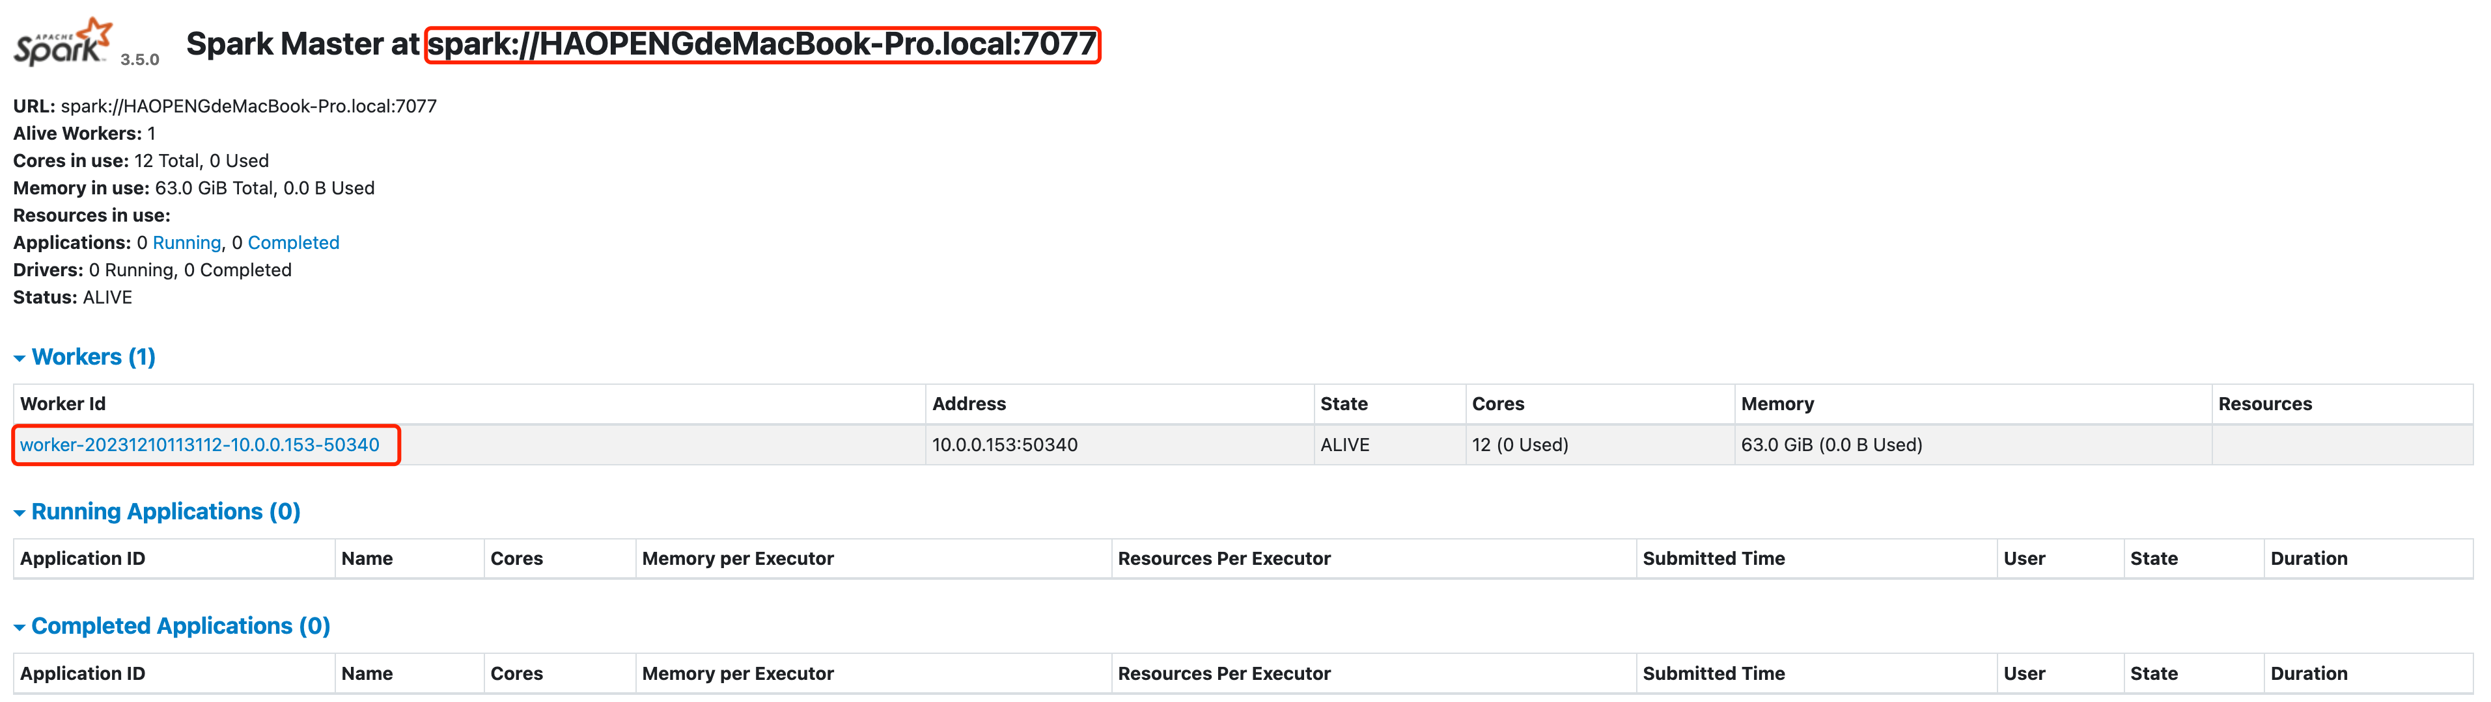
Spark Standalone Mode

Slide 20
Spark Standalone Mode
Cluster Launch Scripts
To launch a Spark standalone cluster with the launch scripts, you should create a file called conf/workers in your Spark directory, which must contain the hostnames of all the machines where you intend to start Spark workers, one per line.
If conf/workers does not exist, the launch scripts defaults to a single machine (localhost), which is useful for testing.
Once you’ve set up this file, you can launch or stop your cluster with the following shell scripts, based on Hadoop’s deploy scripts, and available in SPARK_HOME/sbin:
sbin/start-master.sh - Starts a master instance on the machine the script is executed on.
sbin/start-workers.sh - Starts a worker instance on each machine specified in the conf/workers file.
sbin/start-worker.sh - Starts a worker instance on the machine the script is executed on.
sbin/start-all.sh - Starts both a master and a number of workers as described above.
sbin/stop-master.sh - Stops the master that was started via the sbin/start-master.sh script.
sbin/stop-worker.sh - Stops all worker instances on the machine the script is executed on.
sbin/stop-workers.sh - Stops all worker instances on the machines specified in the conf/workers file.
sbin/stop-all.sh - Stops both the master and the workers as described above.

Slide 21
Quick Start
Interactive Analysis with the Spark Shell
Spark’s shell provides a simple way to learn the API, as well as a powerful tool to analyze data interactively. It is available in either Scala (which runs on the Java VM and is thus a good way to use existing Java libraries) or Python.
Start it by running the following in the Spark directory:
Scala: $ ./bin/spark-shell
Python: $ ./bin/pyspark
Welcome to
____ __
/ __/__ ___ _____/ /__
_\ \/ _ \/ _ `/ __/ '_/
/___/ .__/\_,_/_/ /_/\_\ version 3.5.0
/_/
Using Scala version 2.12.18 (OpenJDK 64-Bit Server VM, Java 20.0.2)
Type in expressions to have them evaluated.
Type :help for more information.

Slide 22
Quick Start
Spark’s primary abstraction is a distributed collection of items called a Dataset.
Datasets can be created from Hadoop InputFormats (such as HDFS files) or by transforming other Datasets.
Let’s make a new DataFrame from the text of the README file in the Spark source directory:
scala> val textFile = spark.read.textFile("README.md")
textFile: org.apache.spark.sql.Dataset[String] = [value: string]
scala> textFile.count()
res0: Long = 125
scala> textFile.first()
res1: String = # Apache Spark
scala> val linesWithSpark = textFile.filter(line => line.contains("Spark"))
linesWithSpark: org.apache.spark.sql.Dataset[String] = [value: string]
scala> textFile.filter(line => line.contains("Spark")).count() // How many lines contain "Spark"?
res2: Long = 20
scala> textFile.map(line => line.split(" ").size).reduce((a, b) => if (a > b) a else b)
res3: Int = 16

Slide 23
Quick Start
Spark’s primary abstraction is a distributed collection of items called a Dataset.
scala> import java.lang.Math
import java.lang.Math
scala> textFile.map(line => line.split(" ").size).reduce((a, b) => Math.max(a, b))
res4: Int = 16
scala> val wordCounts = textFile.flatMap(line => line.split(" ")).groupByKey(identity).count()
wordCounts: org.apache.spark.sql.Dataset[(String, Long)] = [key: string, count(1): bigint]
scala> wordCounts.collect()
res5: Array[(String, Long)] = Array(([![PySpark,1), (online,1), (graphs,1), (["Building,1), (documentation,3), (command,,2), (abbreviated,1), (overview,1), (rich,1), (set,2), (-DskipTests,1), (1,000,000,000:,2), (name,1), (["Specifying,1), (stream,1), (run:,1), (not,1), (programs,2), (tests,2), (./dev/run-tests,1), (will,1), ([run,1), (particular,2), (Alternatively,,1), (must,1), (using,3), (./build/mvn,1), (you,4), (MLlib,1), (DataFrames,,1), (variable,1), (Note,1), (core,1), (protocols,1), (Guide](https://spark.apache.org/docs/latest/configuration.html),1), (guidance,2), (shell:,2), (can,6), (site,,1), (*,4), (systems.,1), ([building,1), (configure,1), (for,12), (README,1), (Interactive,2), (how,3), ([Configuration,1), (Hive,2), (provides,1), (Hadoop-supporte...

Slide 24
Quick Start
Caching
Spark also supports pulling data sets into a cluster-wide in-memory cache.
This is very useful when data is accessed repeatedly, such as when querying a small “hot” dataset or when running an iterative algorithm like PageRank.
As a simple example, let’s mark our linesWithSpark dataset to be cached:
scala> linesWithSpark.cache()
res6: linesWithSpark.type = [value: string]
scala> linesWithSpark.count()
res7: Long = 20
scala> linesWithSpark.count()
res8: Long = 20

Slide 25
Quick Start
We’ll create a very simple Spark application, SimpleApp.java:
/* SimpleApp.java */ import org.apache.spark.api.java.function.FilterFunction; import org.apache.spark.sql.SparkSession; import org.apache.spark.sql.Dataset; public class SimpleApp { public static void main(String[] args) { String logFile = "/Users/haopengchen/spark-3.5.0-bin-hadoop3/README.md"; // Should be some file on your system SparkSession spark = SparkSession.builder().appName("Simple Application").getOrCreate(); Dataset<String> logData = spark.read().textFile(logFile).cache(); long numAs = logData.filter((FilterFunction<String>) s -> s.contains("a")).count(); long numBs = logData.filter((FilterFunction<String>) s -> s.contains("b")).count(); System.out.println("Lines with a: " + numAs + ", lines with b: " + numBs); spark.stop(); } }

Slide 26
Quick Start
We’ll create a very simple Spark application, SimpleApp.java:
<build> <plugins> <plugin> <groupId>org.apache.maven.plugins</groupId> <artifactId>maven-compiler-plugin</artifactId> <configuration> <source>8</source> <target>8</target> </configuration> </plugin> </plugins> </build>
<dependencies> <dependency> <groupId>org.apache.spark</groupId> <artifactId>spark-core_2.13</artifactId> <version>3.5.0</version> </dependency> <dependency> <groupId>org.apache.spark</groupId> <artifactId>spark-sql_2.13</artifactId> <version>3.5.0</version> <scope>provided</scope> </dependency> </dependencies>

Slide 27
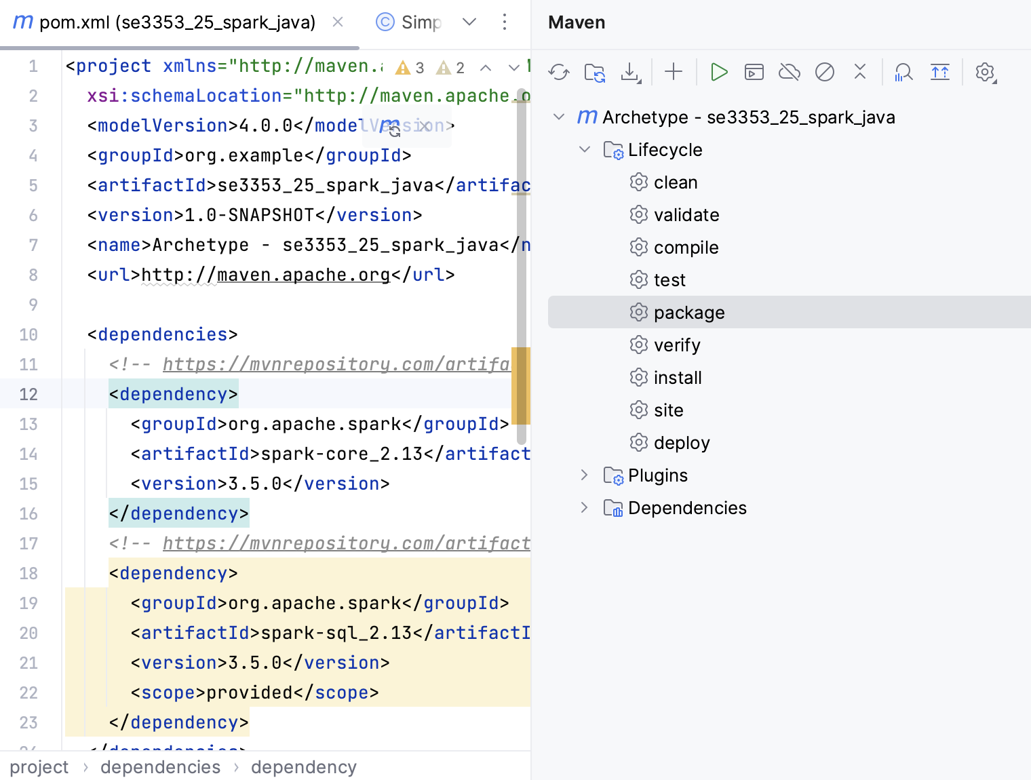
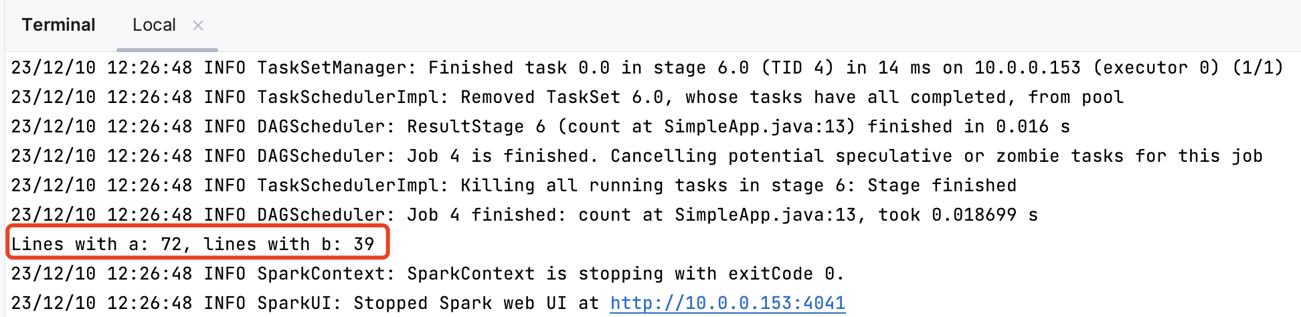
Quick Start
We’ll create a very simple Spark application, SimpleApp.java:
/Users/haopengchen/spark-3.5.0-bin-hadoop3/bin/spark-submit \ --class "SimpleApp" \ --master spark://HAOPENGdeMacBook-Pro.local:7077 \ target/se3353_25_spark_java-1.0-SNAPSHOT.jar

Slide 28
Quick Start
We’ll create a very simple Spark application in Scala–so simple, in fact, that it’s named SimpleApp.scala:
/* SimpleApp.scala */
import org.apache.spark.sql.SparkSession
object SimpleApp {
def main(args: Array[String]) {
val logFile = "YOUR_SPARK_HOME/README.md" // Should be some file on your system
val spark = SparkSession.builder.appName("Simple Application").getOrCreate()
val logData = spark.read.textFile(logFile).cache()
val numAs = logData.filter(line => line.contains("a")).count()
val numBs = logData.filter(line => line.contains("b")).count()
println(s"Lines with a: $numAs, Lines with b: $numBs")
spark.stop()
}
}

Slide 29
Quick Start
Our application depends on the Spark API, so we’ll also include an sbt configuration file, build.sbt,
which explains that Spark is a dependency.
This file also adds a repository that Spark depends on:
ThisBuild / version := "0.1.0-SNAPSHOT" ThisBuild / scalaVersion := "2.13.12" lazy val root = (project in file(".")) .settings( name := "se3353_25_spark_scala" ) ThisBuild / libraryDependencies += "org.apache.spark" %% "spark-sql" % "3.5.0"

Slide 30
Quick Start
For sbt to work correctly, we’ll need to
layout SimpleApp.scala and build.sbt according to the typical directory structure. Once that is in place, we can create a JAR package containing the application’s code, then use the spark-submit script to run our program.
# Your directory layout should look like this
$ find .
.
./build.sbt
./src
./src/main
./src/main/scala
./src/main/scala/SimpleApp.scala
# Package a jar containing your application
$ sbt package
...
[info] Packaging {..}/{..}/target/scala-2.12/simple-project_2.12-1.0.jar
# Use spark-submit to run your application
$ YOUR_SPARK_HOME/bin/spark-submit \
--class "SimpleApp" \
--master local\
target/scala-2.13/se3353_26_spark_2.13-0.1.jar
...
Lines with a: 46, Lines with b: 23

Slide 31
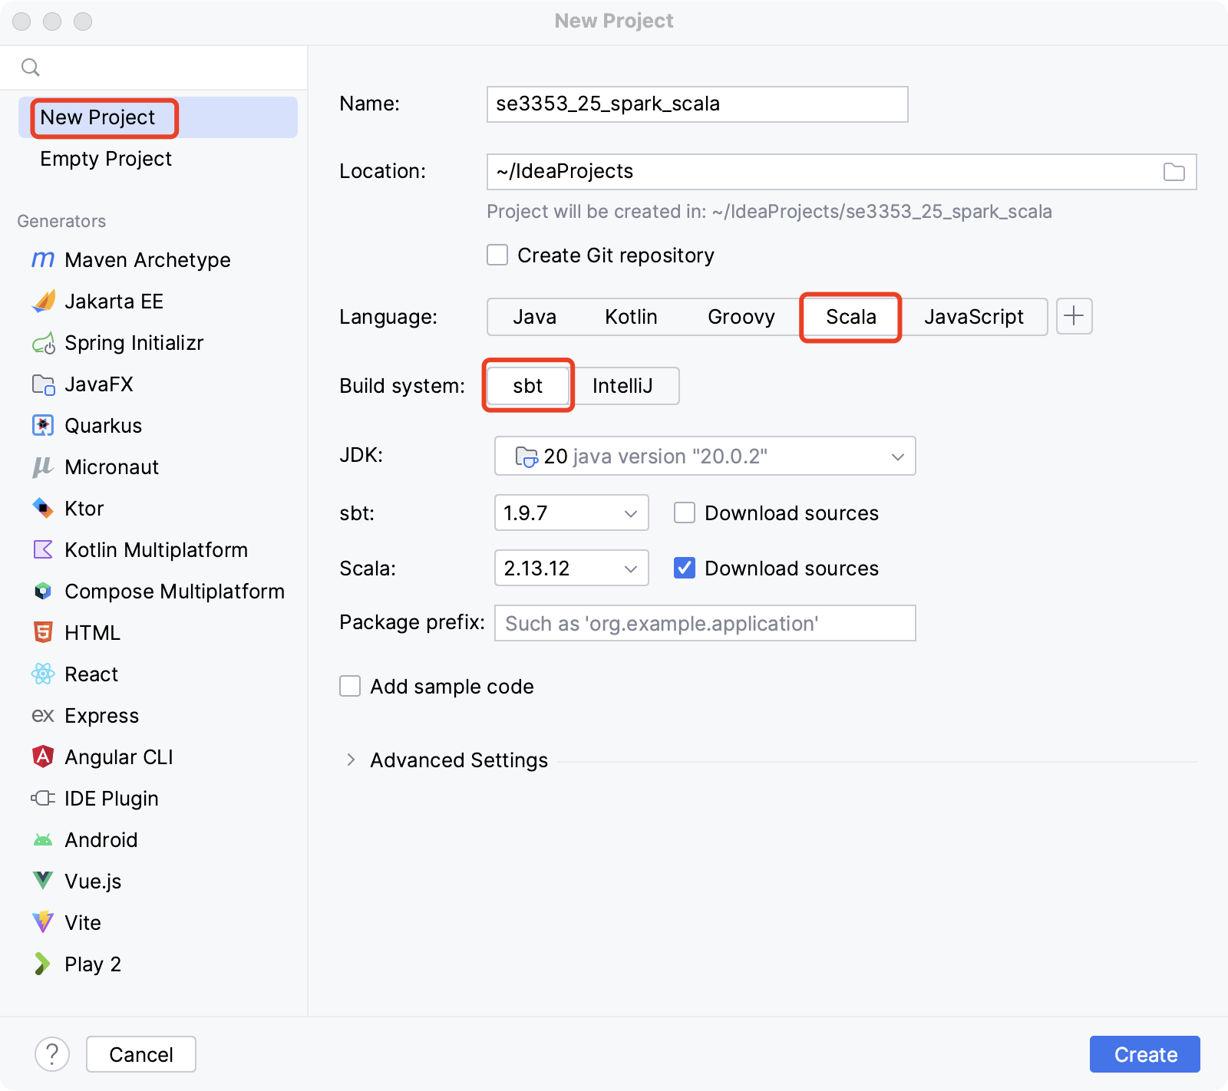
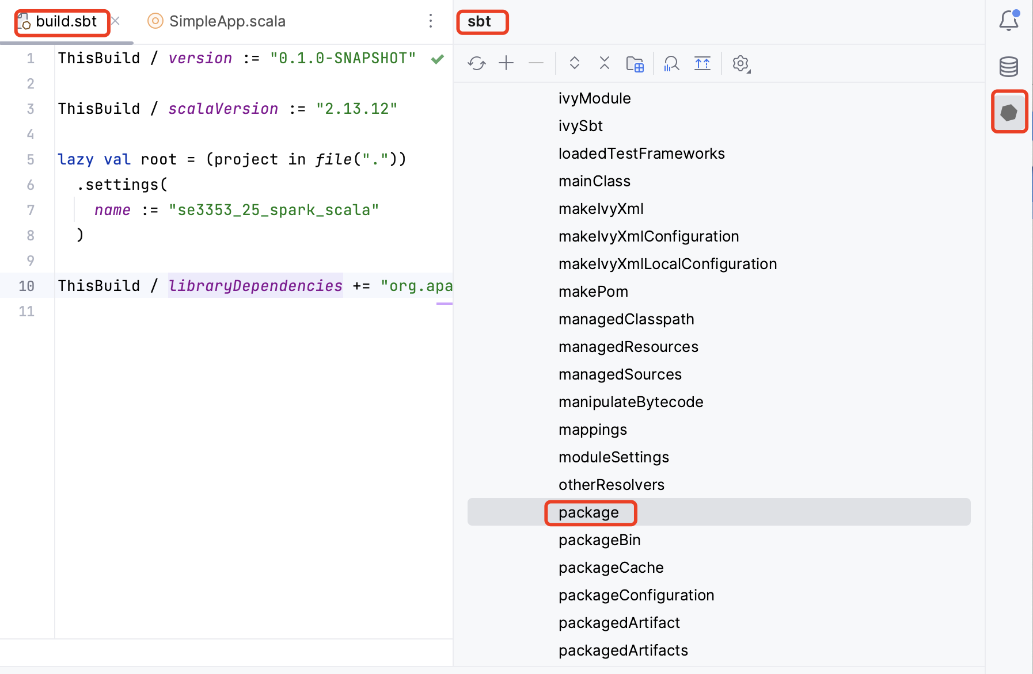
Quick Start

Slide 32
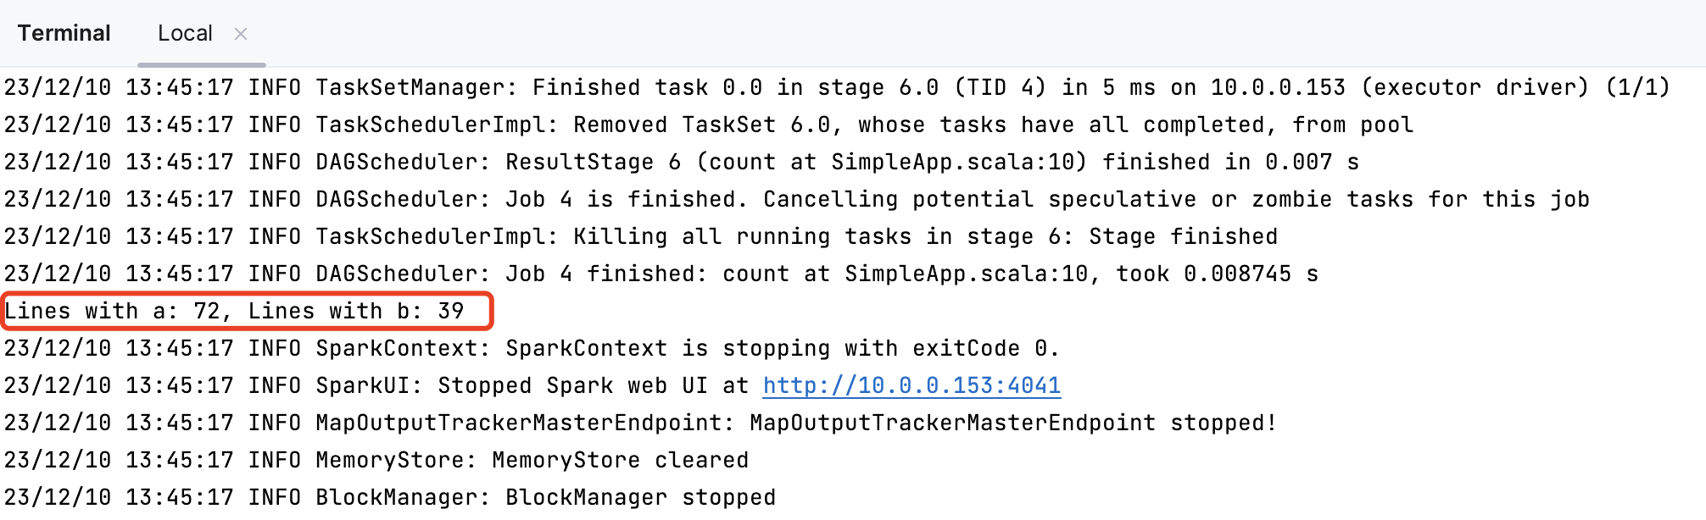
Quick Start

Slide 33
Quick Start
Python Application
"""SimpleApp.py""" from pyspark.sql import SparkSession logFile = "/Users/chenhaopeng/spark-3.2.0-bin-hadoop3.2/README.md" # Should be some file on your system spark = SparkSession.builder.appName("SimpleApp").getOrCreate() logData = spark.read.text(logFile).cache() numAs = logData.filter(logData.value.contains('a')).count() numBs = logData.filter(logData.value.contains('b')).count() print("Lines with a: %i, lines with b: %i" % (numAs, numBs)) spark.stop()

Slide 34
Quick Start
Python Application
$ /Users/haopengchen/spark-3.5.0-bin-hadoop3/bin/spark-submit \ --class "SimpleApp" \ --master local \ SimpleApp.py

Slide 35
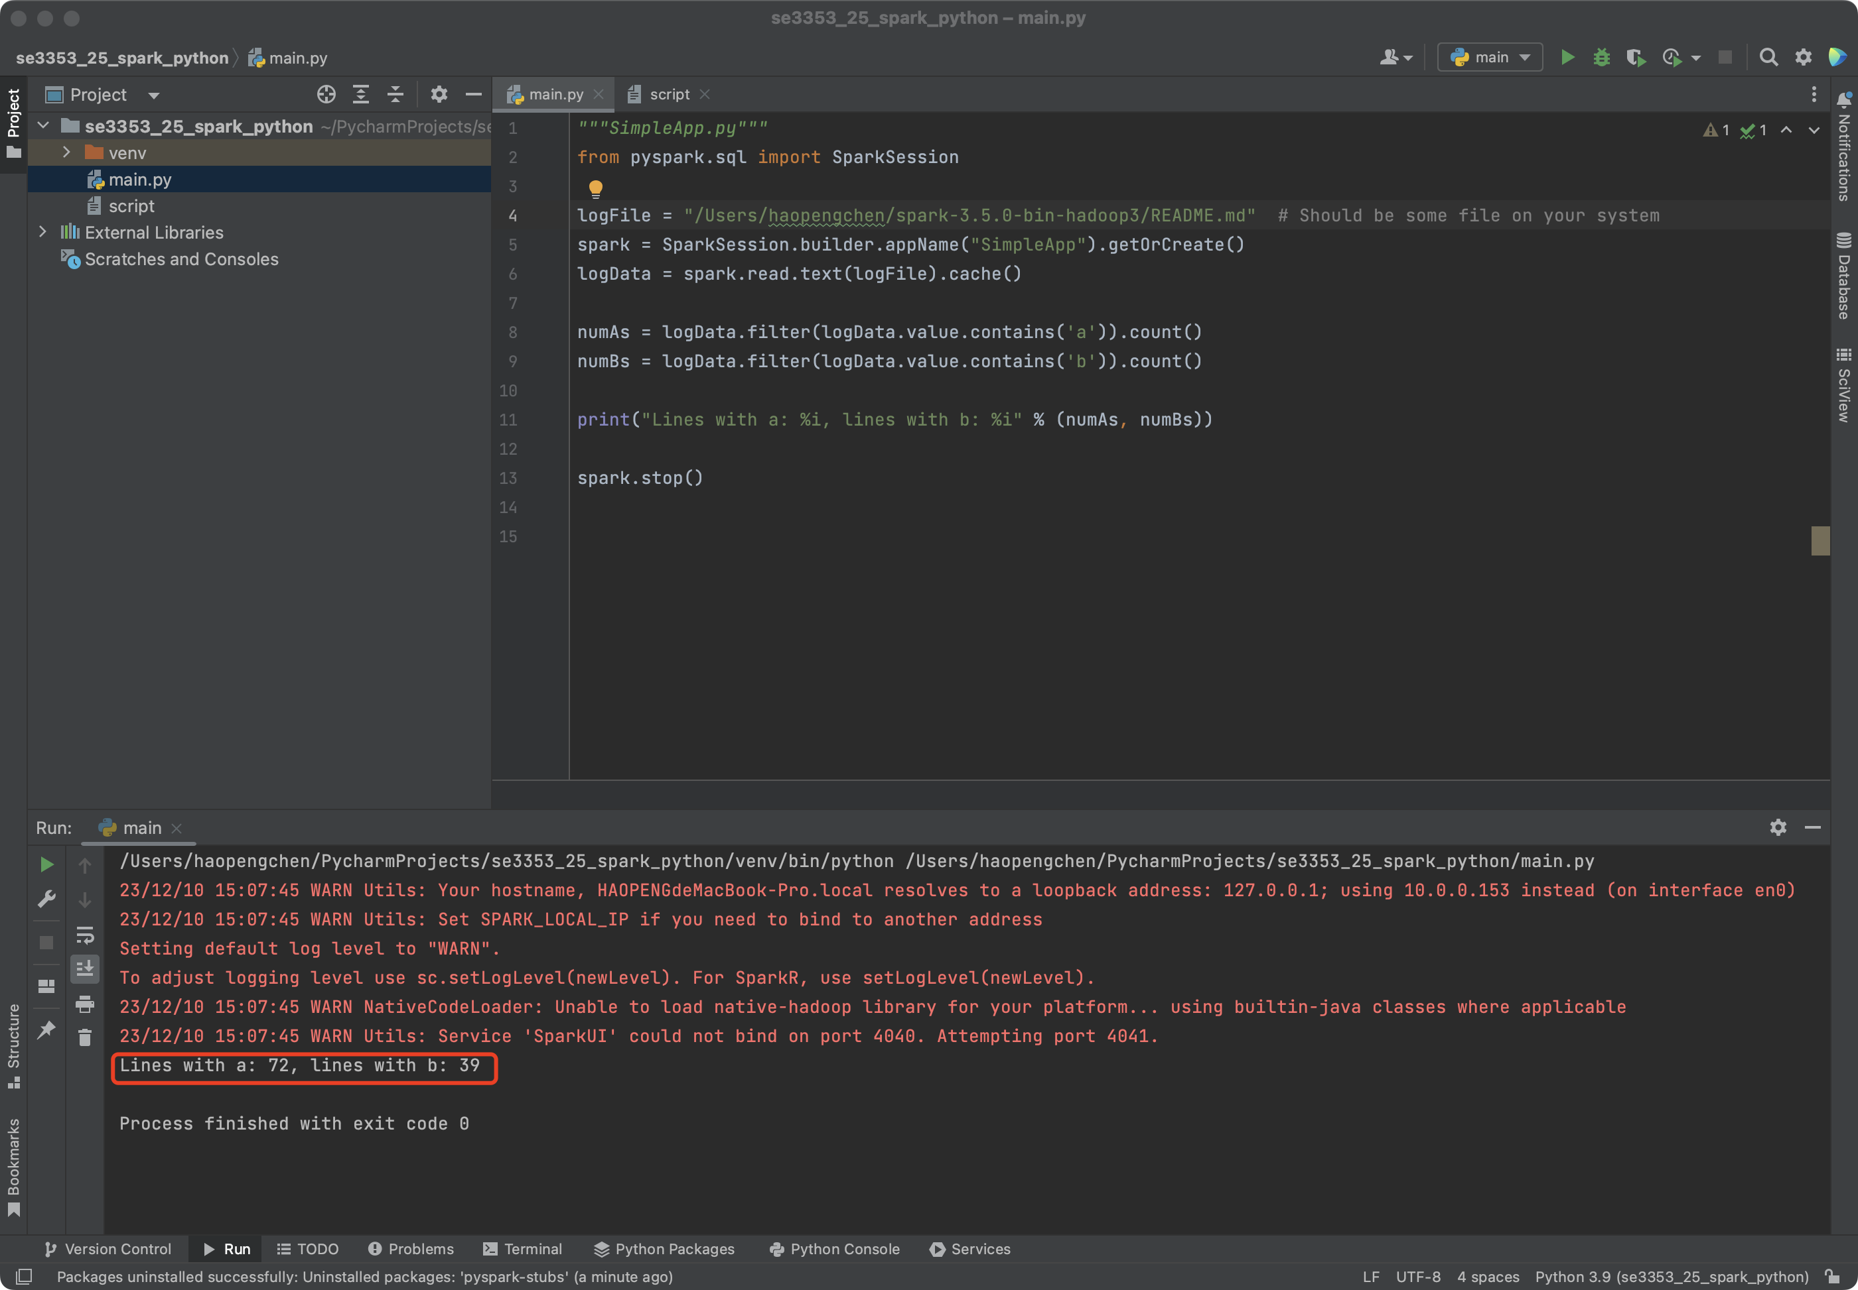
Quick Start

Slide 36
Spark RDD
Resilient Distributed Datasets (RDDs)
Spark revolves around the concept of a resilient distributed dataset (RDD), which is a fault-tolerant collection of elements that can be operated on in parallel.
There are two ways to create RDDs: parallelizing an existing collection in your driver program, or referencing a dataset in an external storage system, such as a shared filesystem, HDFS, HBase, or any data source offering a Hadoop InputFormat.
Parallelized Collections
Parallelized collections are created by calling SparkContext’s parallelize method on an existing collection in your driver program
val data = Array(1, 2, 3, 4, 5)
val distData = sc.parallelize(data)

Slide 37
Spark RDD
External Datasets
Spark can create distributed datasets from any storage source supported by Hadoop, including your local file system, HDFS, Cassandra, HBase, Amazon S3, etc.
Spark supports text files, SequenceFiles, and any other Hadoop InputFormat.
scala> val distFile = sc.textFile("data.txt")
distFile: org.apache.spark.rdd.RDD[String] = data.txt MapPartitionsRDD[10] at textFile at <console>:26
Partition
One important parameter for parallel collections is the number of partitions to cut the dataset into.
Spark will run one task for each partition of the cluster.

Slide 38
RDD Operations
RDDs support two types of operations:
transformations, which create a new dataset from an existing one, and
actions, which return a value to the driver program after running a computation on the dataset.
For example, map is a transformation that passes each dataset element through a function and returns a new RDD representing the results.
On the other hand, reduce is an action that aggregates all the elements of the RDD using some function and returns the final result to the driver program.

Slide 39
RDD Operations
All transformations in Spark are lazy,
in that they do not compute their results right away.
Instead, they just remember the transformations applied to some base dataset (e.g. a file). The transformations are only computed when an action requires a result to be returned to the driver program.
This design enables Spark to run more efficiently. For example, we can realize that a dataset created through map will be used in a reduce and return only the result of the reduce to the driver, rather than the larger mapped dataset.
By default, each transformed RDD may be recomputed each time you run an action on it. However, you may also persist an RDD in memory using the persist (or cache) method, in which case Spark will keep the elements around on the cluster for much faster access the next time you query it.
There is also support for persisting RDDs on disk, or replicated across multiple nodes.

Slide 40
RDD Transformations
map
nums = sc.parallelize([1, 2, 3, 4])
squared = nums.map(lambda x: x * x).collect()
flatMap
lines = sc.parallelize(["hello world", "hi"])
words = lines.flatMap(lambda line: line.split(" "))

Slide 41
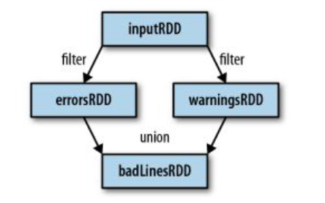
RDD Transformations
filter
inputRDD = sc.textFile("log.txt")
errorsRDD = inputRDD.filter(lamda x: "error" in x)
warningsRDD = inputRDD.filter(lamda x: "warning" in x)
union
badLinesRDD = errorsRDD.union(warningsRDD)

Slide 42
RDD Transformations
For RDD {1, 2, 3, 3}
Transformations | Meaning | Example | Result
map(func) | Return a new distributed dataset formed by passing each element of the source through a function func. | rdd.map(x => x + 1 ) | {2, 3, 4, 4}
flatMap(func) | Similar to map, but each input item can be mapped to 0 or more output items (so func should return a Seq rather than a single item). | rdd.flatMap(x => x.to(3) ) | {1, 2, 3, 2, 3, 3, 3}
filter(func) | Return a new dataset formed by selecting those elements of the source on which func returns true. | rdd.filter(x => x != 1 ) | {2, 3, 3}
distinct() | Return a new dataset that contains the distinct elements of the source dataset. | rdd.distinct() | {1, 2, 3}

Slide 43
RDD Transformations
For RDDs {1, 2, 3} and {3, 4, 5}
Transformations | Meaning | Example | Result
union(otherDataset) | Return a new dataset that contains the union of the elements in the source dataset and the argument. | rdd.union(other) | {1, 2, 3, 3, 4, 5}
intersection (otherDataset) | Return a new RDD that contains the intersection of elements in the source dataset and the argument. | rdd.intersection(other) | {3}
cartesian (otherDataset) | When called on datasets of types T and U, returns a dataset of (T, U) pairs (all pairs of elements). | rdd.cartesian(other) | {(1, 3), (1, 4), ..., (3,5)}

Slide 44
RDD Actions
reduce
rdd = sc.parallelize([1, 2, 3, 4])
sum = rdd.reduce(lambda x, y: x + y)
count
为每个输入元素产生多个输出元素
print “Input had” + badLinesRDD.count() + "concerning lines"

Slide 45
RDD Actions
For RDD {1, 2, 3, 3}
Actions | Meaning | Example | Result
collect() | Return all the elements of the dataset as an array at the driver program. This is usually useful after a filter or other operation that returns a sufficiently small subset of the data. | rdd.collect() | {1, 2, 3, 3}
count() | Return the number of elements in the dataset. | rdd.count() | 4
reduce(func) | Aggregate the elements of the dataset using a function func (which takes two arguments and returns one). The function should be commutative and associative so that it can be computed correctly in parallel. | rdd.reduce((x,y) => x+y) | 9

Slide 46
Spark 程序流程示例
基本流程示例
从外部数据创建一些作为输入的RDD
使用类似filter之类的变换(Transformations)来定义出新的RDD
要求Spark对需要重用的任何中间RDD进行persist
启用类似count之类的动作(Actions)进行并行计算

Slide 47
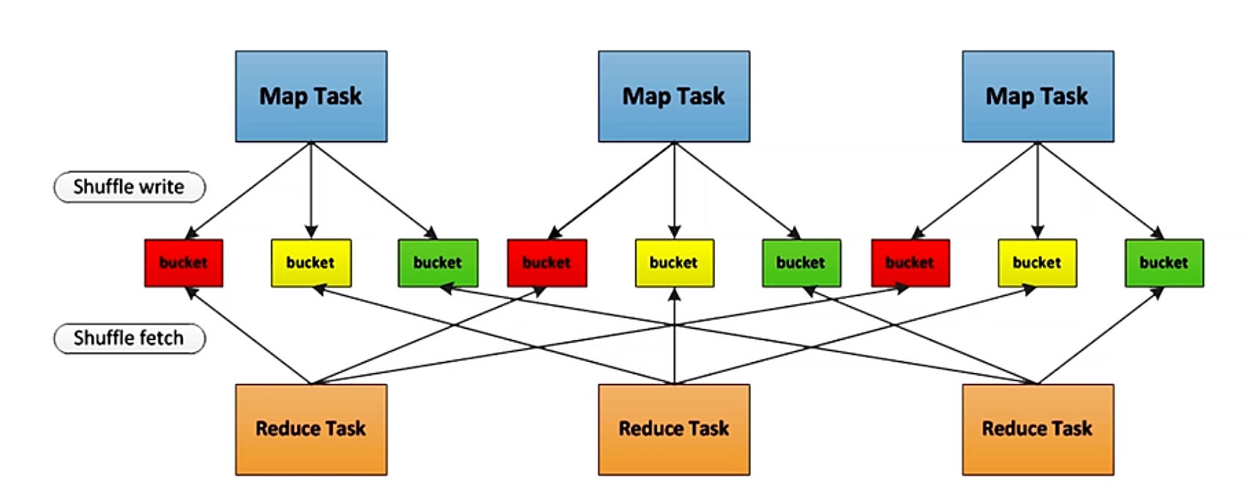
Shuffle Operation
Certain operations within Spark trigger an event known as the shuffle.
The shuffle is Spark’s mechanism for re-distributing data so that it’s grouped differently across partitions. This typically involves copying data across executors and machines, making the shuffle a complex and costly operation.
The Shuffle is an expensive operation since it involves disk I/O, data serialization, and network I/O.

Slide 48
Partitions
An Easy Example
假设程序在内存中持有一个非常大的用户信息表 (UserID，UserInfo) ，其中UserInfo 包含用户订阅的主题列表
有一个很小的表，记录过去5分钟里在网页上点击过链接的事件，键值对为(UserID, LinkInfo)
程序周期性地将这两个表合并、查询

Slide 49
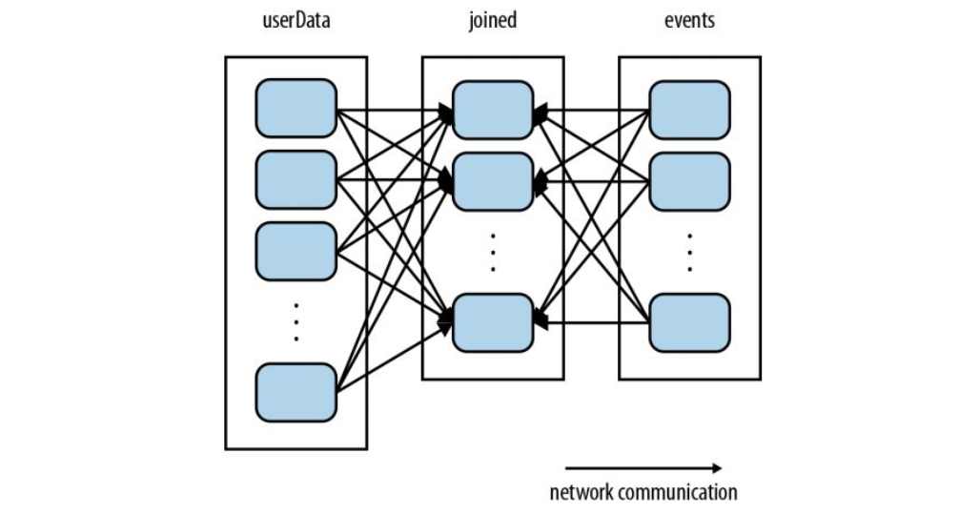
Partitions
No Partitions
join操作不知道数据集中的主键如何分区
userData需要周期性地进行Hash并Shuffle，即使其没发生任何变化

Slide 50
Partitions
partitionBy - 指定分区
指定分区
Spark 知道其为哈希分区，在执行join时会利用这一信息
val sc = new SparkContext(...) val userData = sc.sequenceFile[UserID, UserInfo]("hdfs://...") .partitionBy(new HashPartitioner(100)) // Create 100 partitions .persist()

Slide 51
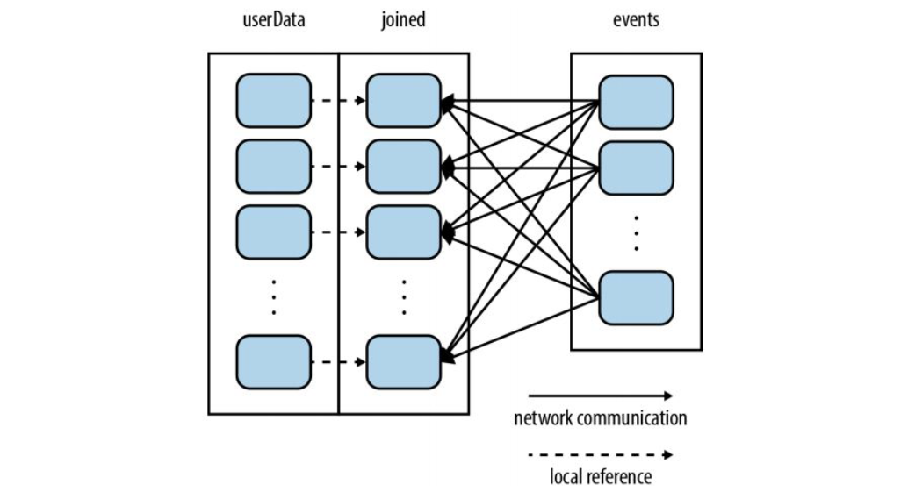
Partitions

Slide 52
Dependencies
Narrow Dependencies
窄依赖
父RDD的每个分区只被子RDD的一个分区所使用
map, union, …
Wide Dependencies
宽依赖
父RDD的每个分区都可能被多个子RDD分区所使用
Shuffle
Join with inputs not co-partitioned, …

Slide 53
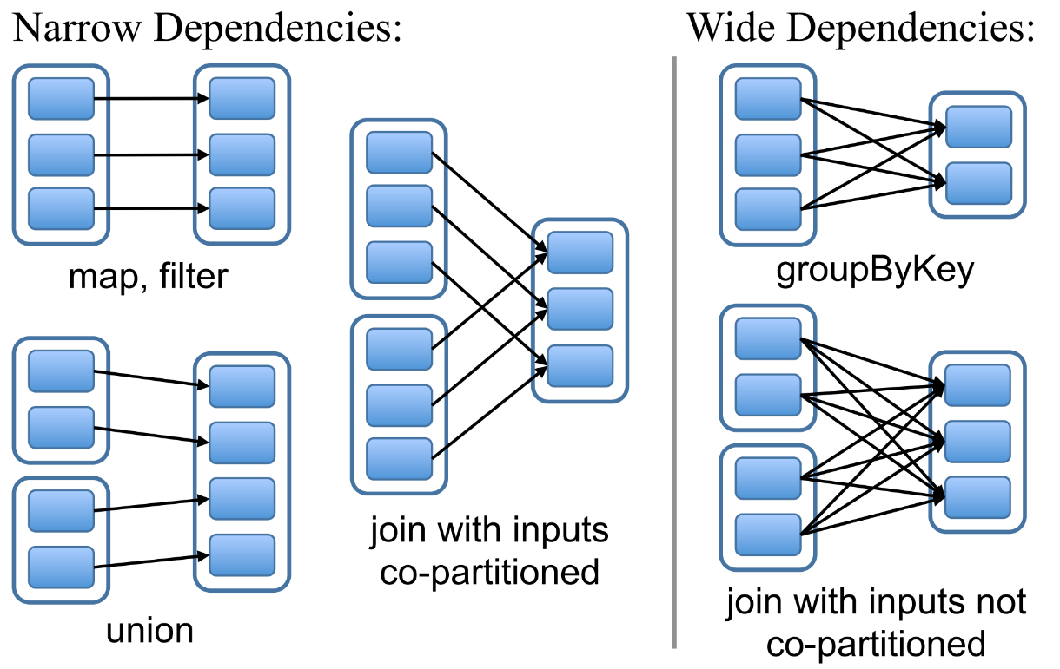
Dependencies

Slide 54
Dependencies
Narrow Dependencies VS. Wide Dependencies
宽依赖往往意味着Shuffle操作，可能涉及多个节点的数据传输
当RDD分区丢失时，Spark会对数据进行重算
窄依赖只需计算丢失RDD的父分区，不同节点间可以并行计算，能更有效地进行节点的恢复
宽依赖中，重算的子RDD分区往往来源自多个父RDD分区，其中只有一部分数据用于恢复，造成了不必要的冗余，甚至需要整体重新计算

Slide 55
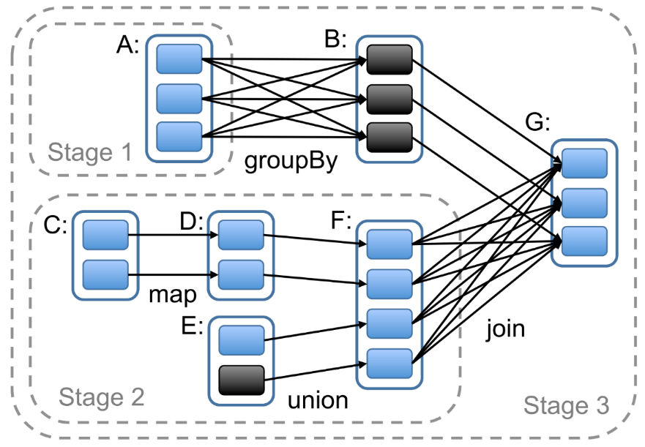
Stage
Stage
每个阶段stage内部尽可能多地包含一组具有窄依赖关系的transformations操作，以便将它们流水线并行化（pipeline）
边界有两种情况：一是宽依赖上的Shuffle操作；二是已缓存分区
Notes:
Spark怎样划分任务阶段（stage）的例子：实线方框表示RDD，实心矩形表示分区（黑色表示该分区被缓存）。要在RDD G上执行一个动作，调度器根据宽依赖创建一组stage，并在每个stage内部将具有窄依赖的转换流水线化（pipeline）。 本例不用再执行stage 1，因为B已经存在于缓存中了，所以只需要运行stage2和3。

Slide 56
RDD Persistence
One of the most important capabilities in Spark is persisting (or caching) a dataset in memory across operations.
When you persist an RDD, each node stores any partitions of it that it computes in memory and reuses them in other actions on that dataset (or datasets derived from it).
You can mark an RDD to be persisted using the persist() or cache() methods on it.
The first time it is computed in an action, it will be kept in memory on the nodes.
Spark’s cache is fault-tolerant – if any partition of an RDD is lost, it will automatically be recomputed using the transformations that originally created it.

Slide 57
RDD Persistence
In addition, each persisted RDD can be stored using a different storage level.
The full set of storage levels is:
Storage Level | Meaning
MEMORY_ONLY | Store RDD as deserialized Java objects in the JVM. If the RDD does not fit in memory, some partitions will not be cached and will be recomputed on the fly each time they're needed. This is the default level.
MEMORY_AND_DISK | Store RDD as deserialized Java objects in the JVM. If the RDD does not fit in memory, store the partitions that don't fit on disk, and read them from there when they're needed.
MEMORY_ONLY_SER (Java and Scala) | Store RDD as serialized Java objects (one byte array per partition). This is generally more space-efficient than deserialized objects, especially when using a fast serializer, but more CPU-intensive to read.
MEMORY_AND_DISK_SER (Java and Scala) | Similar to MEMORY_ONLY_SER, but spill partitions that don't fit in memory to disk instead of recomputing them on the fly each time they're needed.
DISK_ONLY | Store the RDD partitions only on disk.
MEMORY_ONLY_2, MEMORY_AND_DISK_2, etc. | Same as the levels above, but replicate each partition on two cluster nodes.
OFF_HEAP (experimental) | Similar to MEMORY_ONLY_SER, but store the data in off-heap memory. This requires off-heap memory to be enabled.

Slide 58
RDD Persistence
Removing Data
Spark automatically monitors cache usage on each node and drops out old data partitions in a least-recently-used (LRU) fashion.
If you would like to manually remove an RDD instead of waiting for it to fall out of the cache, use the RDD.unpersist() method.
Note that this method does not block by default.
To block until resources are freed, specify blocking=true when calling this method.

Slide 59
Spark SQL
Spark SQL
Spark SQL is a Spark module for structured data processing.
Unlike the basic Spark RDD API, the interfaces provided by Spark SQL provide Spark with more information about the structure of both the data and the computation being performed.
Internally, Spark SQL uses this extra information to perform extra optimizations.
There are several ways to interact with Spark SQL including SQL and the Dataset API.
When computing a result, the same execution engine is used, independent of which API/language you are using to express the computation.
This unification means that developers can easily switch back and forth between different APIs based on which provides the most natural way to express a given transformation.

Slide 60
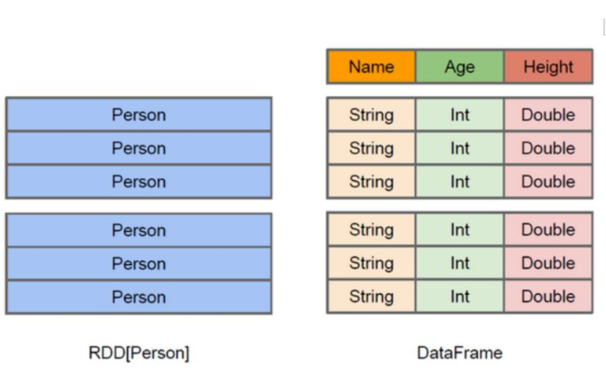
Datasets and DataFrames
A Dataset is a distributed collection of data.
A Dataset can be constructed from JVM objects and then manipulated using functional transformations (map, flatMap, filter, etc.).
A DataFrame is a Dataset organized into named columns.
It is conceptually equivalent to a table in a relational database or a data frame in R/Python, but with richer optimizations under the hood.
DataFrames can be constructed from a wide array of sources such as: structured data files, tables in Hive, external databases, or existing RDDs.

Slide 61
Creating DataFrames
With a SparkSession, applications can create DataFrames from an existing RDD, from a Hive table, or from Spark data sources.
As an example, the following creates a DataFrame based on the content of a JSON file:
val df = spark.read.json("examples/src/main/resources/people.json")
// Displays the content of the DataFrame to stdout
df.show()
// +----+-------+
// | age| name|
// +----+-------+
// |null|Michael|
// | 30| Andy|
// | 19| Justin|
// +----+-------+

Slide 62
Untyped Dataset Operations
// Select people older than 21 df.filter($"age" > 21).show() // +---+----+ // |age|name| // +---+----+ // | 30|Andy| // +---+----+ // Count people by age df.groupBy("age").count().show() // +----+-----+ // | age|count| // +----+-----+ // | 19| 1| // |null| 1| // | 30| 1| // +----+-----+ // $example off:untyped_ops$
// This import is needed to use the $-notation import spark.implicits._
// Print the schema in a tree format df.printSchema() // root // |-- age: long (nullable = true) // |-- name: string (nullable = true) // Select only the "name" column df.select("name").show() // +-------+ // | name| // +-------+ // |Michael| // | Andy| // | Justin| // +-------+ // Select everybody, but increment the age by 1 df.select($"name", $"age" + 1).show() // +-------+---------+ // | name|(age + 1)| // +-------+---------+ // |Michael| null| // | Andy| 31| // | Justin| 20| // +-------+---------+

Slide 63
Running SQL Queries Programmatically
The sql function on a SparkSession enables applications to run SQL queries programmatically and returns the result as a DataFrame.
// $example on:run_sql$ // Register the DataFrame as a SQL temporary view df.createOrReplaceTempView("people") val sqlDF = spark.sql("SELECT * FROM people") sqlDF.show() // +----+-------+ // | age| name| // +----+-------+ // |null|Michael| // | 30| Andy| // | 19| Justin| // +----+-------+ // $example off:run_sql$

Slide 64
Global Temporary View
Temporary views in Spark SQL are session-scoped and will disappear if the session that creates it terminates.
If you want to have a temporary view that is shared among all sessions and keep alive until the Spark application terminates, you can create a global temporary view.
// $example on:global_temp_view$ // Register the DataFrame as a global temporary view df.createGlobalTempView("people")

Slide 65
Untyped Dataset Operations
// Global temporary view is tied to a system preserved database `global_temp` spark.sql("SELECT * FROM global_temp.people").show() // +----+-------+ // | age| name| // +----+-------+ // |null|Michael| // | 30| Andy| // | 19| Justin| // +----+-------+ // Global temporary view is cross-session spark.newSession().sql("SELECT * FROM global_temp.people").show() // +----+-------+ // | age| name| // +----+-------+ // |null|Michael| // | 30| Andy| // | 19| Justin| // +----+-------+

Slide 66
Creating Datasets
Datasets are similar to RDDs,
however, instead of using Java serialization or Kryo they use a specialized Encoder to serialize the objects for processing or transmitting over the network.
// $example on:create_ds$ case class Person(name: String, age: Long) // $example off:create_ds$
// Encoders are created for case classes val caseClassDS = Seq(Person("Andy", 32)).toDS() caseClassDS.show() // +----+---+ // |name|age| // +----+---+ // |Andy| 32| // +----+---+

Slide 67
Creating Datasets
// Encoders for most common types are automatically provided by importing spark.implicits._ val primitiveDS = Seq(1, 2, 3).toDS() primitiveDS.map(_ + 1).collect() // Returns: Array(2, 3, 4) // DataFrames can be converted to a Dataset by providing a class. Mapping will be done by name val path = "examples/src/main/resources/people.json" val peopleDS = spark.read.json(path).as[Person] peopleDS.show() // +----+-------+ // | age| name| // +----+-------+ // |null|Michael| // | 30| Andy| // | 19| Justin| // +----+-------+ // $example off:create_ds$

Slide 68
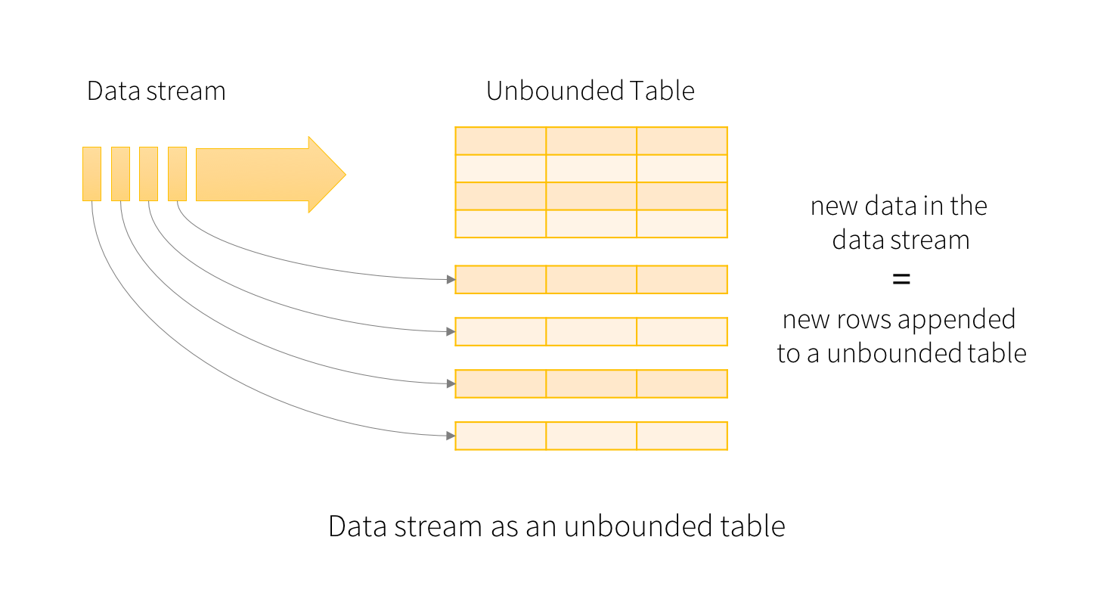
Other Issues
Structured Streaming
a scalable and fault-tolerant stream processing engine built on the Spark SQL engine.

Slide 69
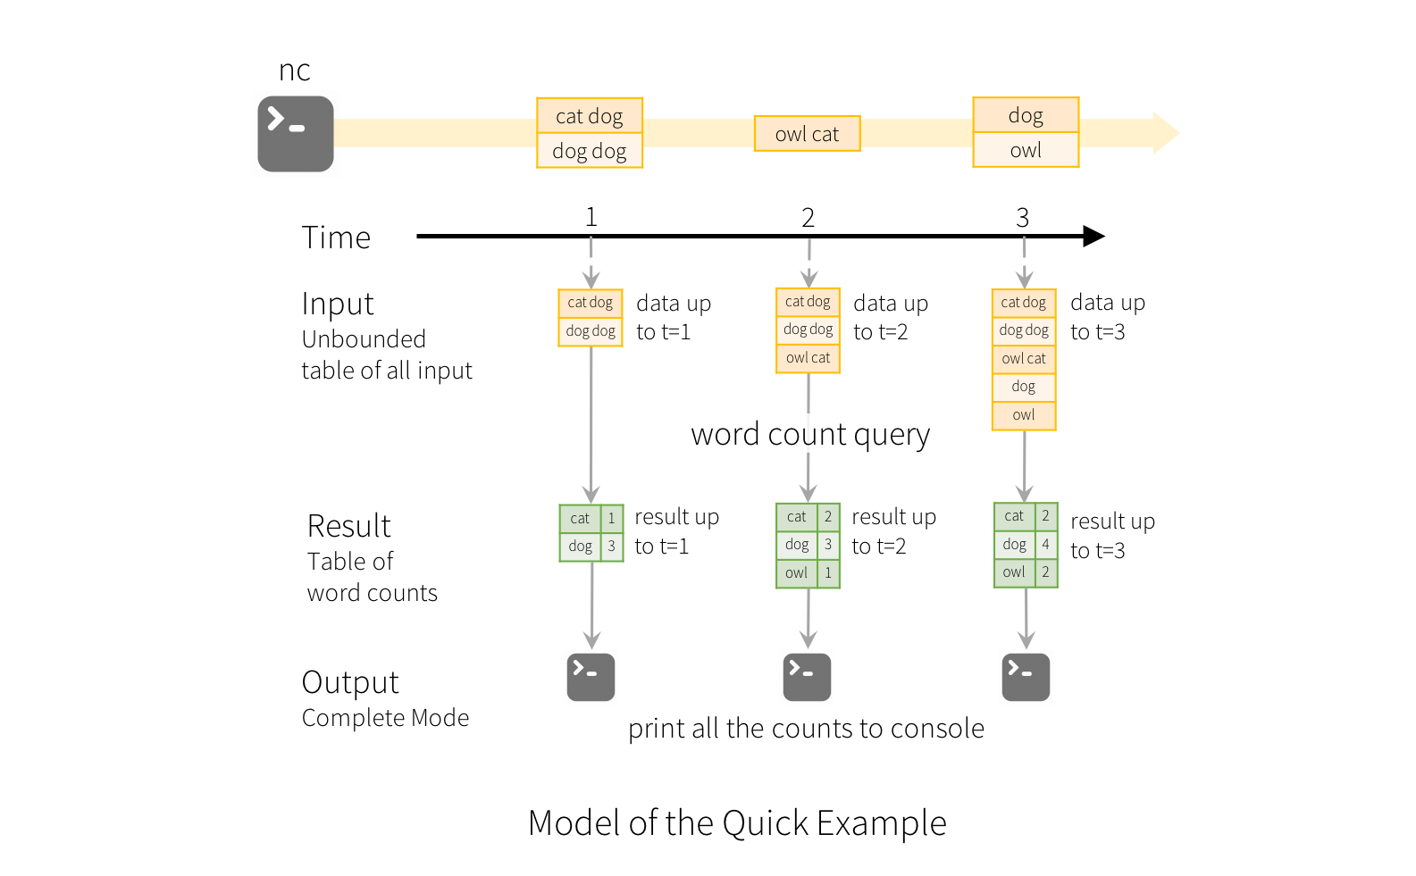
Other Issues

Slide 70
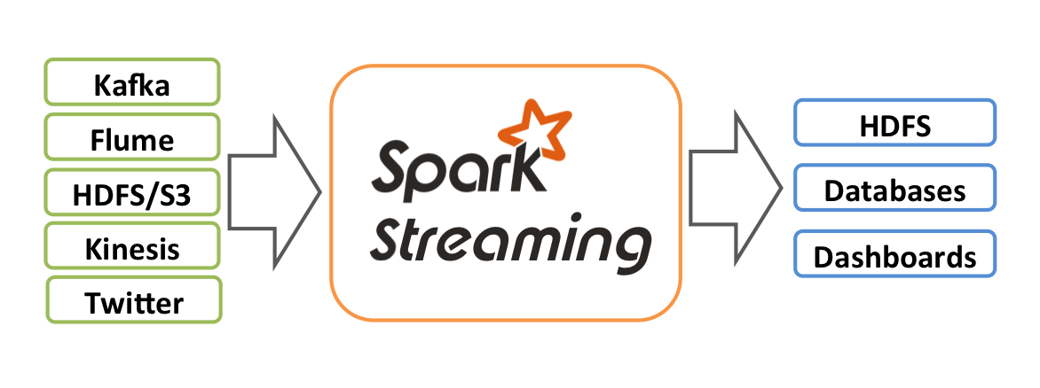
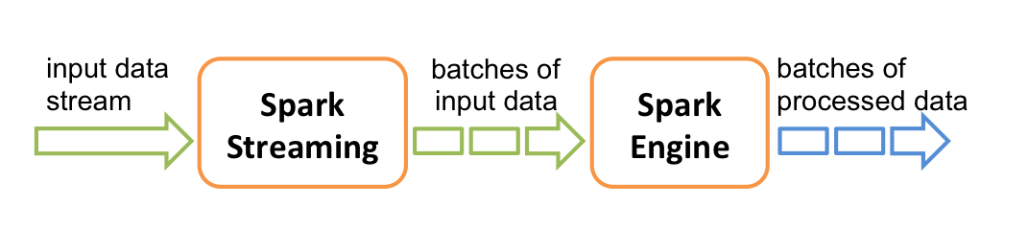
Other Issues
Spark Streaming
an extension of the core Spark API that enables scalable, high-throughput, fault-tolerant stream processing of live data streams.

Slide 71
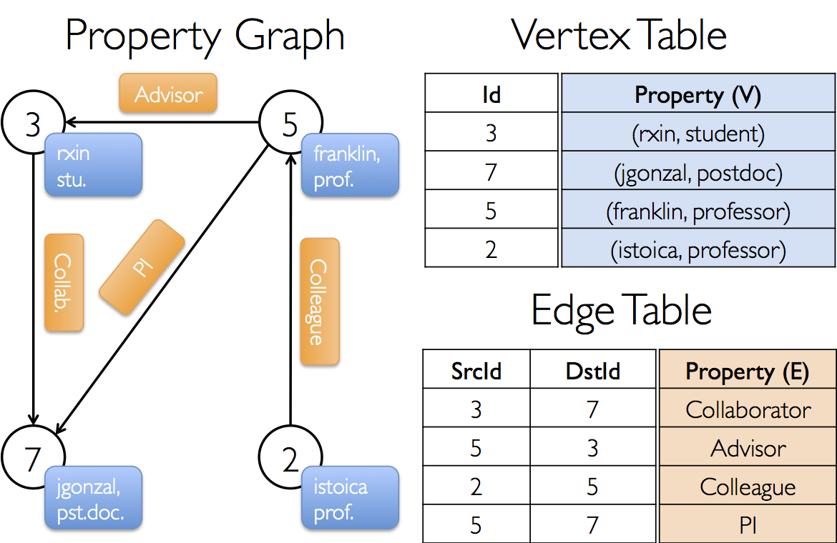
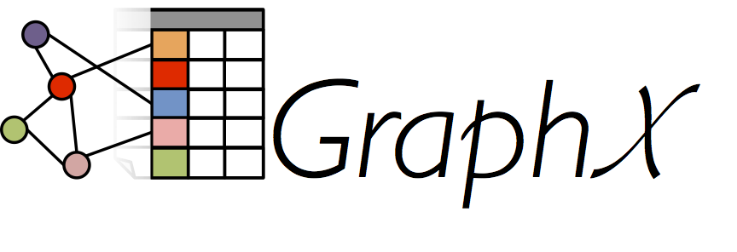
Other Issues
Machine Learning Library (MLlib) Guide
MLlib is Spark’s machine learning (ML) library. Its goal is to make practical machine learning scalable and easy. At a high level, it provides tools such as:
GraphX
a new component in Spark for graphs and graph-parallel computation.
At a high level, GraphX extends the Spark RDD by introducing a new Graph abstraction: a directed multigraph with properties attached to each vertex and edge.

Slide 72
References
Spark Standalone Mode
https://spark.apache.org/docs/latest/spark-standalone.html
Cluster Mode Overview
https://spark.apache.org/docs/latest/cluster-overview.html
Quick Start
https://spark.apache.org/docs/latest/quick-start.html
RDD Programming Guide
https://spark.apache.org/docs/latest/rdd-programming-guide.html
Spark SQL, DataFrames and Datasets Guide
https://spark.apache.org/docs/latest/sql-programming-guide.html
Python
http://spark.apache.org/docs/latest/api/python/index.html
Java
http://spark.apache.org/docs/latest/api/java/index.html
Scala
http://spark.apache.org/docs/latest/api/scala/index.html

Slide 73
References
Structured Streaming Programming Guide
https://spark.apache.org/docs/latest/structured-streaming-programming-guide.html
Spark Streaming Programming Guide
https://spark.apache.org/docs/latest/streaming-programming-guide.html
Machine Learning Library (MLlib) Guide
https://spark.apache.org/docs/latest/ml-guide.html
GraphX Programming Guide
https://spark.apache.org/docs/latest/graphx-programming-guide.html
How to Set up Scala in IntelliJ IDEA?
https://javahelps.com/how-to-set-up-scala-in-intellij-idea

Slide 74

Thank You!

